Slide 1


Slide 2
H ow are design ideas communicated in a team environment?
If the software is large scale, employing perhaps dozens of developers over several years, it is important that all members of the development team communicate using a common language.
This isn’t meant to imply that they all need to be fluent in English or C++, but it does mean that they need to be able to describe their software’s operation and design to another person.
That is, the ideas in the head of say the analyst have to be conveyed to the designer in some way so that he/she can implement that idea in code.

Slide 3
Just as mathematicians use algebra and electronics engineers have evolved circuit notation and theory to describe their ideas, software engineers have evolved their own notation for describing the architecture and behaviour of software system.
That notation is called UML. The Unified Modelling Language. Some might prefer the title Universal Modelling language since it can be used to model many things besides software.

Slide 4
What is UML ?
UML is not a language in the same way that we view programming languages such as ‘C++’, ‘Java’ or ‘Basic’.
UML is however a language in the sense that it has syntax and semantics which convey meaning, understanding and constraints (i.e. what is right and wrong and the limitations of those decisions) to the reader and thereby allows two people fluent in that language to communicate and understand the intention of the other.
UML represents a collection of 13 essentially graphical (i.e. drawing) notations supplemented by textual descriptions designed to capture requirements and design alternatives. You don’t have to use them all, you just chose the ones that capture important information about the system you are working on.

Slide 5
What is UML ?
UML is to software engineers what building plans are to an architect and an electrical circuit diagrams is to an electrician.
Note: UML does not work well for small projects or projects where just a few developers are involved. If you attempt to use it in this environment it will seem more of a burden than an aid, but then it was never intended for that. It works best for very complex systems involving dozens of developers over a long period of time where it is impossible for one or two people to maintain the structure of the software in their head as they develop it.

Slide 6
Use Case Diagrams:
  A simple but very effective model used during the analysis phase for analysing requirements through the process of exploring user interactions with the system.
  The process involves documenting
    Who initiates an interaction,
    What information goes into the system,
    What information comes out and
    What the measurable benefit is to the user who initiates the interaction (i.e. what they get out of it).
  Requirements analysis attempts to uncover and document the services the system provides to the user.

Slide 7

Use Case is one way of representing system functionality.
Use case refers to
  A system’s behavior (functionality)
  A set of activities that produce some output.

Slide 8
A Use Case is a term in UML:
    Represents a high-level functional requirement
Use case representation is more well-defined and has agreed documentation:
    Compared to a high-level functional requirement and its documentation
    Therefore many organizations document the functional requirements in terms of use cases

Slide 9

A diagram representing system’s behavior—use cases and actors.
Provides a global look of a system – it’s basic functionality - (use cases) and environment (actors).
Use case diagrams describe what a system does from the standpoint of an external observer. The emphasis is on what a system does rather than how.
Useful for early structuring of requirements; iterative revisions.

Slide 10

Req 1:
    Once user selects the “search” option,
      He is asked to enter the key words.
      The system should output details of all books
      whose title or author name matches any of the key words entered.
      Details include: Title, Author name, publisher name, Year of Publication, ISBN Number, Catalog Number, Location in the library

Slide 11
Req 2:
    When the “renew” option is selected,
      The user is asked to enter his membership number and password.
      After password validation
      The list of the books borrowed by him are displayed.
      The user can renew any of the books
      By clicking in the corresponding renew box.

Slide 12

A high-level function:
    Usually involves a series of interactions between the system and one or more users
Even for the same high-level function,
      There can be different interaction sequences (or scenarios)
      Due to users selecting different options or entering different data items

Slide 13

Each use case in a use case diagram describes one and only one function in which users interact with the system
  May contain several “paths” that a user can take while interacting with the system
  Each path is referred to as a scenario
Notes:
Use Case
In reading a use case, you should not be able to tell if an activity is computerized or manual
Used to document the current system (AS-IS system) or the new system being developed (TO-BE system)
Communicates at a high level what the system needs to do
Captures the typical interaction of the system with the system’s users
Logical model
Physical details are defined during the design phase

Slide 14

Labelled using a descriptive verb-noun phrase
Represented by an oval
Make Appointment
Make
Appointment
Notes:
Use case: A use case in a use case diagram is a visual representation of a distinct business functionality in a system. The key term here is "distinct business functionality." To choose a business process as a likely candidate for modeling as a use case, you need to ensure that the business process is discrete in nature. As the first step in identifying use cases, you should list the discrete business functions in your problem statement. Each of these business functions can be classified as a potential use case. Remember that identifying use cases is a discovery rather than a creation. As business functionality becomes clearer, the underlying use cases become more easily evident. A use case is shown as an ellipse in a use case diagram Depicted by an oval
MUST label the oval with the name of the use case

Slide 15


Labelled using a descriptive noun or phrase
Represented by a stick character
Notes:
Actors: An actor portrays any entity (or entities) that performs certain roles in a given system. The different roles the actor represents are the actual business roles of users in a given system. An actor in a use case diagram interacts with a use case. For example, for modeling a banking application, a customer entity represents an actor in the application. Similarly, the person who provides service at the counter is also an actor. But it is up to you to consider what actors make an impact on the functionality that you want to model. If an entity does not affect a certain piece of functionality that you are modeling, it makes no sense to represent it as an actor. An actor is shown as a stick figure in a use case diagram depicted "outside" the system boundary, as shown in Make Appointment figure.
Depicted by an oval
MUST label the oval with the name of the use case
To identify an actor, search in the problem statement for business terms that portray roles in the system. For example, in the statement "patients visit the doctor in the clinic for medical tests," "doctor" and "patients" are the business roles and can be easily identified as actors in the system.

Slide 16

Relationships
  Represent communication between actor and use case
  Depicted by line or double-headed arrow line
  Also called association relationship
Make
Appointment
Make Appointment
Notes:
Use Case Relationship
Association relationship
May exist between actor and a use case
Often referred to as a communicate association
Navigable in both directions (actor to use case and use case to actor)
Some use just a line
Others use a double-headed arrowhead
Navigable in only one direction (actor to use case OR use case to actor)
Use a arrowhead where arrowhead denotes the direction of communication
Navigation direction of an association represents who is initiating the communication
Multiplicity
Not consistency shown on all use-case diagrams (Some do; some don’t)

Slide 17

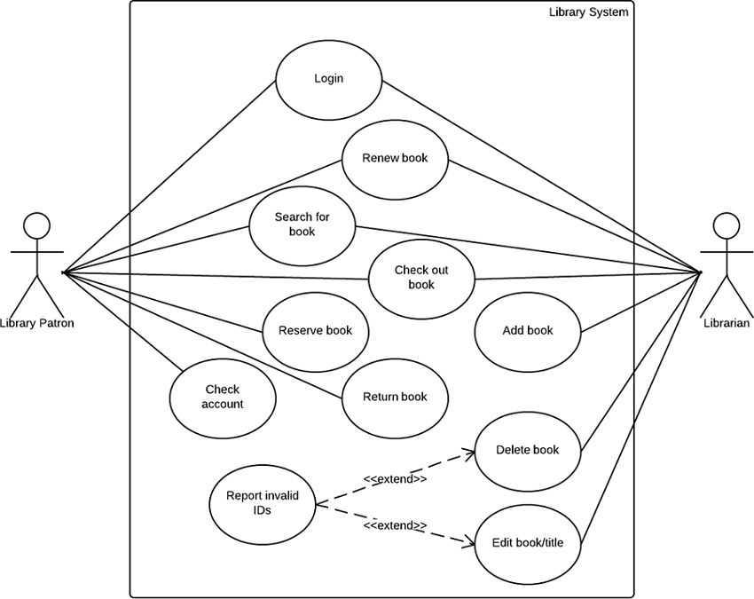
Notes:
Use Case Relationship
Association relationship
May exist between actor and a use case
Often referred to as a communicate association
Navigable in both directions (actor to use case and use case to actor)
Some use just a line
Others use a double-headed arrowhead
Navigable in only one direction (actor to use case OR use case to actor)
Use a arrowhead where arrowhead denotes the direction of communication
Navigation direction of an association represents who is initiating the communication
Multiplicity
Not consistency shown on all use-case diagrams (Some do; some don’t)

Slide 18
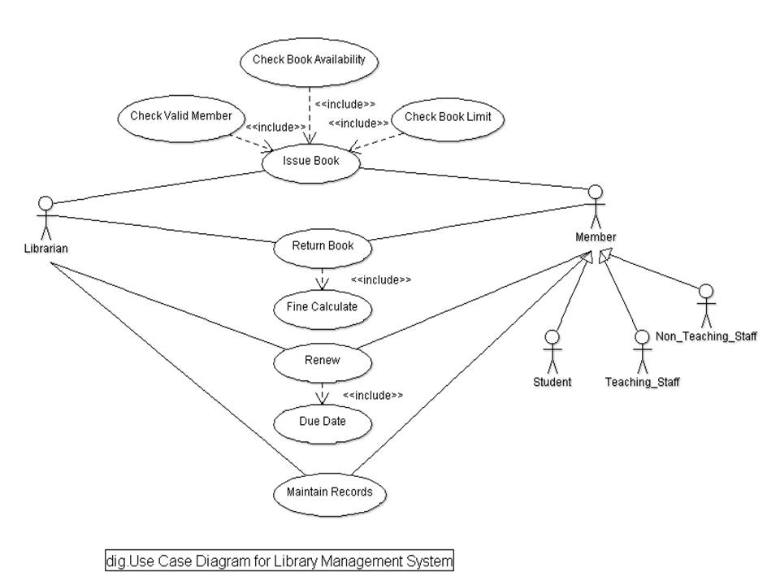
Notes:
Use Case Relationship
Association relationship
May exist between actor and a use case
Often referred to as a communicate association
Navigable in both directions (actor to use case and use case to actor)
Some use just a line
Others use a double-headed arrowhead
Navigable in only one direction (actor to use case OR use case to actor)
Use a arrowhead where arrowhead denotes the direction of communication
Navigation direction of an association represents who is initiating the communication
Multiplicity
Not consistency shown on all use-case diagrams (Some do; some don’t)

Slide 19
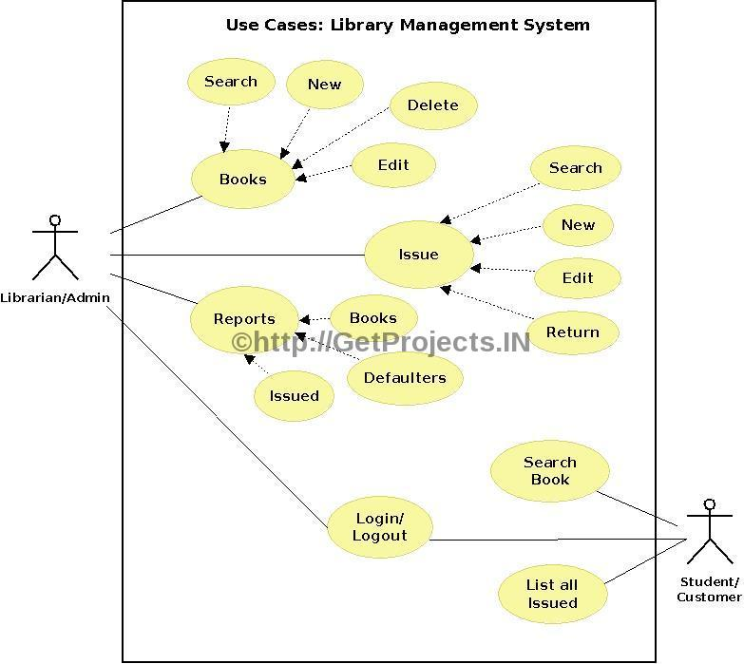
Notes:
Use Case Relationship
Association relationship
May exist between actor and a use case
Often referred to as a communicate association
Navigable in both directions (actor to use case and use case to actor)
Some use just a line
Others use a double-headed arrowhead
Navigable in only one direction (actor to use case OR use case to actor)
Use a arrowhead where arrowhead denotes the direction of communication
Navigation direction of an association represents who is initiating the communication
Multiplicity
Not consistency shown on all use-case diagrams (Some do; some don’t)

Slide 20

Decision Trees
Decision Tables
Notes:
Use Case Relationship
Association relationship
May exist between actor and a use case
Often referred to as a communicate association
Navigable in both directions (actor to use case and use case to actor)
Some use just a line
Others use a double-headed arrowhead
Navigable in only one direction (actor to use case OR use case to actor)
Use a arrowhead where arrowhead denotes the direction of communication
Navigation direction of an association represents who is initiating the communication
Multiplicity
Not consistency shown on all use-case diagrams (Some do; some don’t)

Slide 21
A Decision Tree gives a graphic view of:
    Logic involved in decision making
    Corresponding actions taken
    Edges of a decision tree represents conditions
    Leaf nodes represent actions to be performed.
Notes:
Use Case Relationship
Association relationship
May exist between actor and a use case
Often referred to as a communicate association
Navigable in both directions (actor to use case and use case to actor)
Some use just a line
Others use a double-headed arrowhead
Navigable in only one direction (actor to use case OR use case to actor)
Use a arrowhead where arrowhead denotes the direction of communication
Navigation direction of an association represents who is initiating the communication
Multiplicity
Not consistency shown on all use-case diagrams (Some do; some don’t)

Slide 22

Decision Tables represent:
    Which variables are to be tested
    What actions are to be taken if the conditions are true
    The order in which decision making is performed
Notes:
Use Case Relationship
Association relationship
May exist between actor and a use case
Often referred to as a communicate association
Navigable in both directions (actor to use case and use case to actor)
Some use just a line
Others use a double-headed arrowhead
Navigable in only one direction (actor to use case OR use case to actor)
Use a arrowhead where arrowhead denotes the direction of communication
Navigation direction of an association represents who is initiating the communication
Multiplicity
Not consistency shown on all use-case diagrams (Some do; some don’t)

Slide 23

A decision table shows in a tabular form:
    Processing logic and corresponding actions
Upper rows of the table specify:
    The variables or conditions to be evaluated
Lower rows specify:
    The actions to be taken when the corresponding conditions are satisfied.
Notes:
Use Case Relationship
Association relationship
May exist between actor and a use case
Often referred to as a communicate association
Navigable in both directions (actor to use case and use case to actor)
Some use just a line
Others use a double-headed arrowhead
Navigable in only one direction (actor to use case OR use case to actor)
Use a arrowhead where arrowhead denotes the direction of communication
Navigation direction of an association represents who is initiating the communication
Multiplicity
Not consistency shown on all use-case diagrams (Some do; some don’t)

Slide 24
Develop decision table for the following:
    If the flight is more than half-full and ticket cost is more than Rs. 3000, free meals are served unless it is a domestic flight. The meals are charged on all domestic flights.
Notes:
Use Case Relationship
Association relationship
May exist between actor and a use case
Often referred to as a communicate association
Navigable in both directions (actor to use case and use case to actor)
Some use just a line
Others use a double-headed arrowhead
Navigable in only one direction (actor to use case OR use case to actor)
Use a arrowhead where arrowhead denotes the direction of communication
Navigation direction of an association represents who is initiating the communication
Multiplicity
Not consistency shown on all use-case diagrams (Some do; some don’t)

